Slide 1

Segment customers based on their preferences for different types of travel experiences (adventures, nature, hill stations, water activities, religious sites) and analyze their spending patterns and satisfaction levels.
Team Members:
1.Ayesha Sidhikha.
2.Sameera.

Slide 2
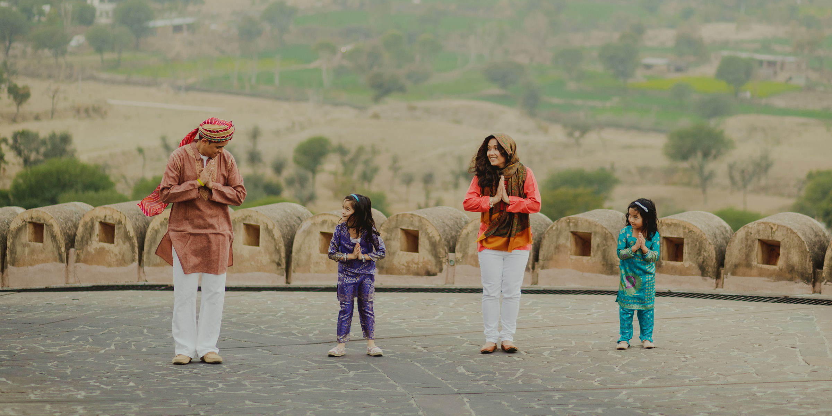
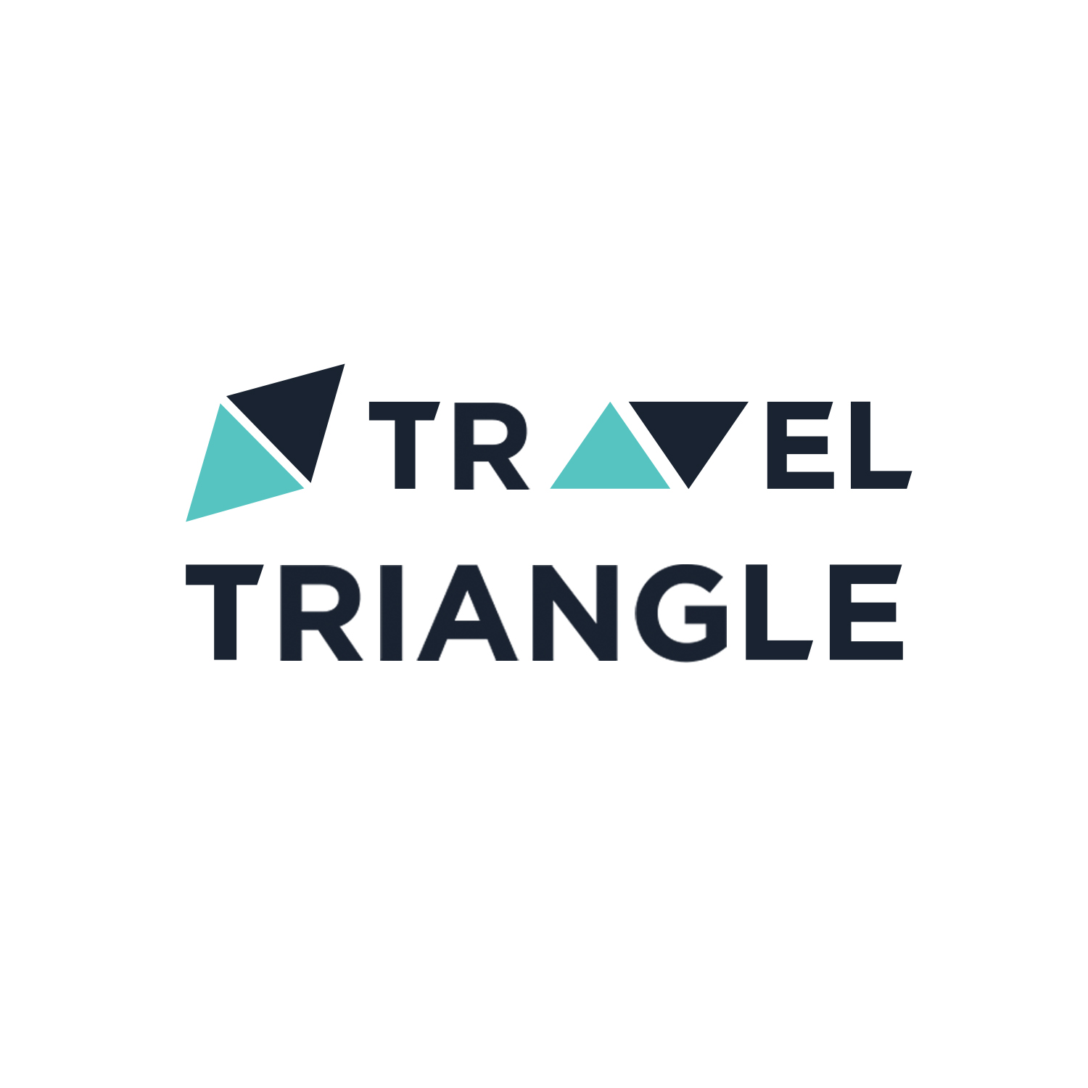
Travel Triangle
A Family holiday packages provider in India
Holiday packages are both a commodity and a service

Slide 3

Problem statement:
Segment customers based on their preferences for different types of travel experiences (adventures, nature, hill stations, water activities, religious sites) and analyze their spending patterns and satisfaction levels.
Goal: To Enhance Customer Experience and Drive Business Growth through Personalized Travel Offerings.
Focus: Personalization, Customer Satisfaction, and Business Growth.
Objective:
Gain insights into customer behavior
Optimize product offerings
Enhance customer satisfaction
Improve business performance

Slide 4



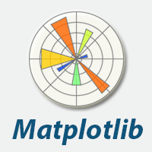


Libraries Used:
Requests
BeautifulSoup
Regex(re)
Pandas
Numpy
Matplotlib
Seaborn
Plotly.express

Slide 5
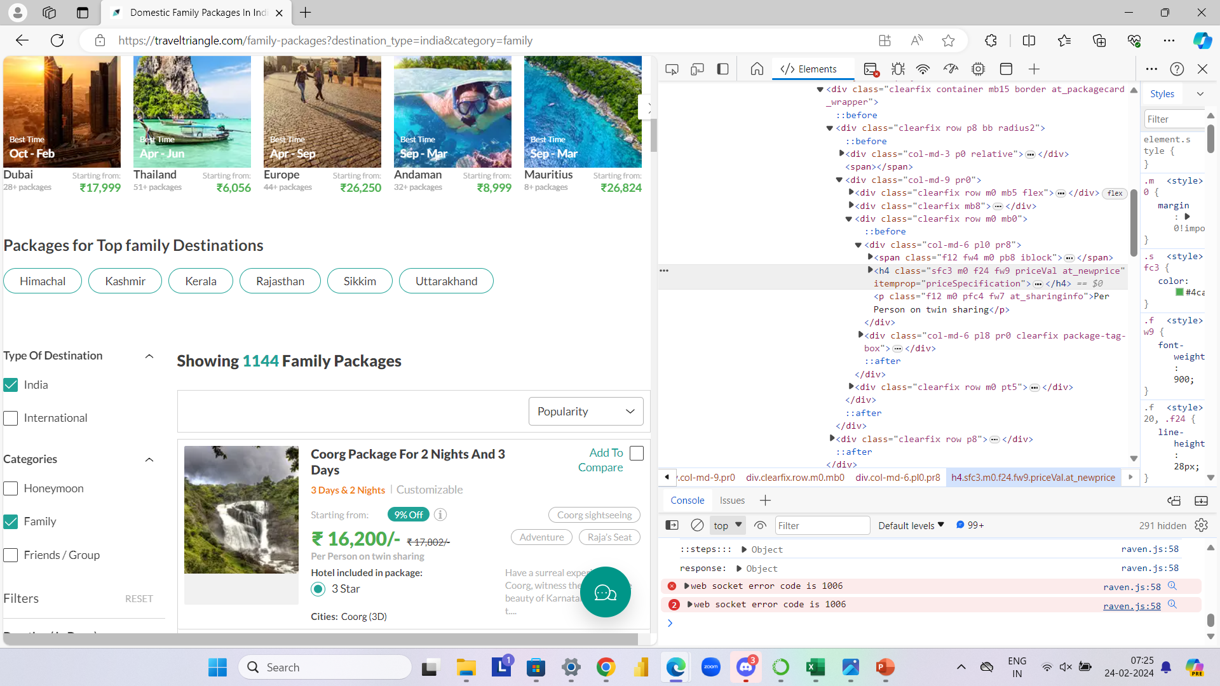
INTERFACE OF THE WEBSITE ALONG WITH THE HTML

Slide 6
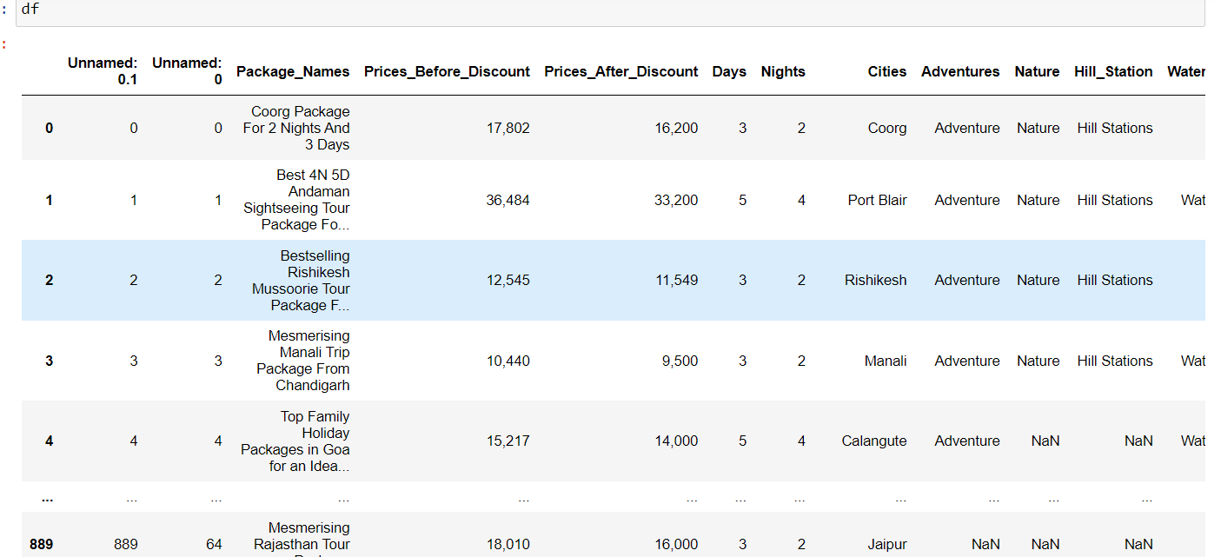
Raw data

Slide 7
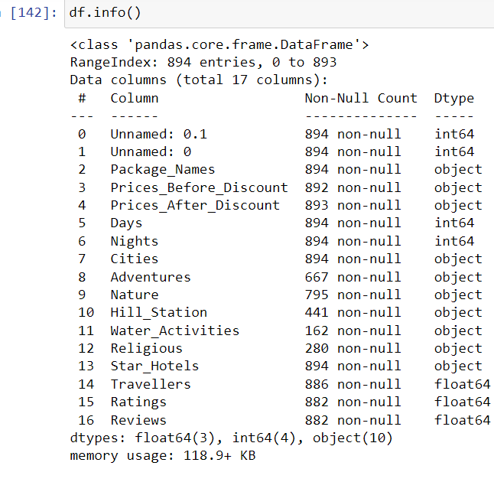
Raw data info()

Slide 8
Process of Data Cleaning :
Check for missing values: This step involves checking for missing values in the data set and filling them in with appropriate values or removing them if necessary.
Data type conversion: This step involves converting data from one data type to another to ensure that it is in the correct format for analysis.
Removing irrelevant data: This step involves removing any data that is not relevant to the analysis By using Regex and split.
Removing irrelevant columns: This step involves removing any columns that are not needed for the analysis or research that is being conducted.
Saving the cleaned data: This step involves saving the cleaned data in a format that is easy to access and analyze.

Slide 9
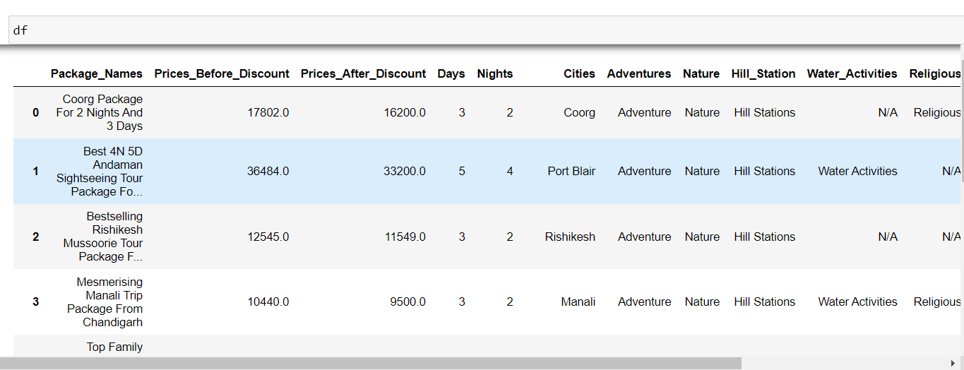
Cleaned Data :
The data has been thoroughly cleaned and organized to ensure accuracy and reliability in our analysis.

Slide 10
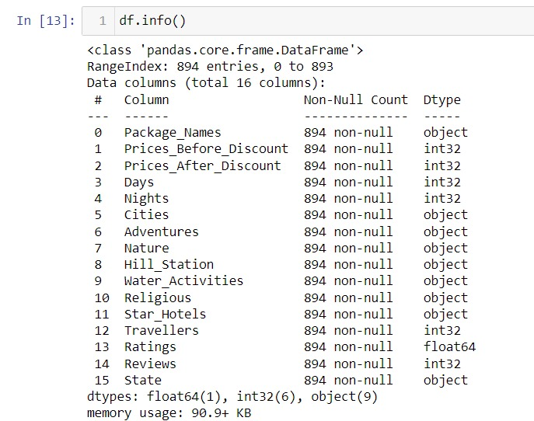
Data Exploration:(After Data Cleaning)
Package_Names: Names of travel packages offered by TravelTriangle.
Prices_Before_Discount: Prices of packages before any discounts are applied.
Prices_After_Discount: Prices of packages after discounts are applied.
Days: Duration of the package in terms of days.
Nights: Duration of the package in terms of nights.
Cities: Destinations or cities included in the travel packages.
Adventures: Indicates if the package includes adventure activities.
Nature: Indicates if the package includes nature-related activities.
Hill_Station: Indicates if the package includes visits to hill stations.
Water_Activities: Indicates if the package includes water-based activities.
Religious: Indicates if the package includes visits to religious sites.
Star_Hotels: Star ratings of hotels included in the package accommodation.
Travellers: Number of travelers per package.
Ratings: Average ratings of the travel packages based on customer feedback.
Reviews: Number of reviews or feedback received for each package.

Slide 11

Data Visualization

Slide 12
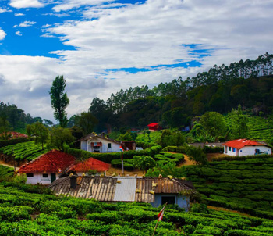
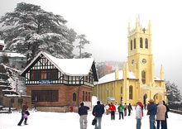
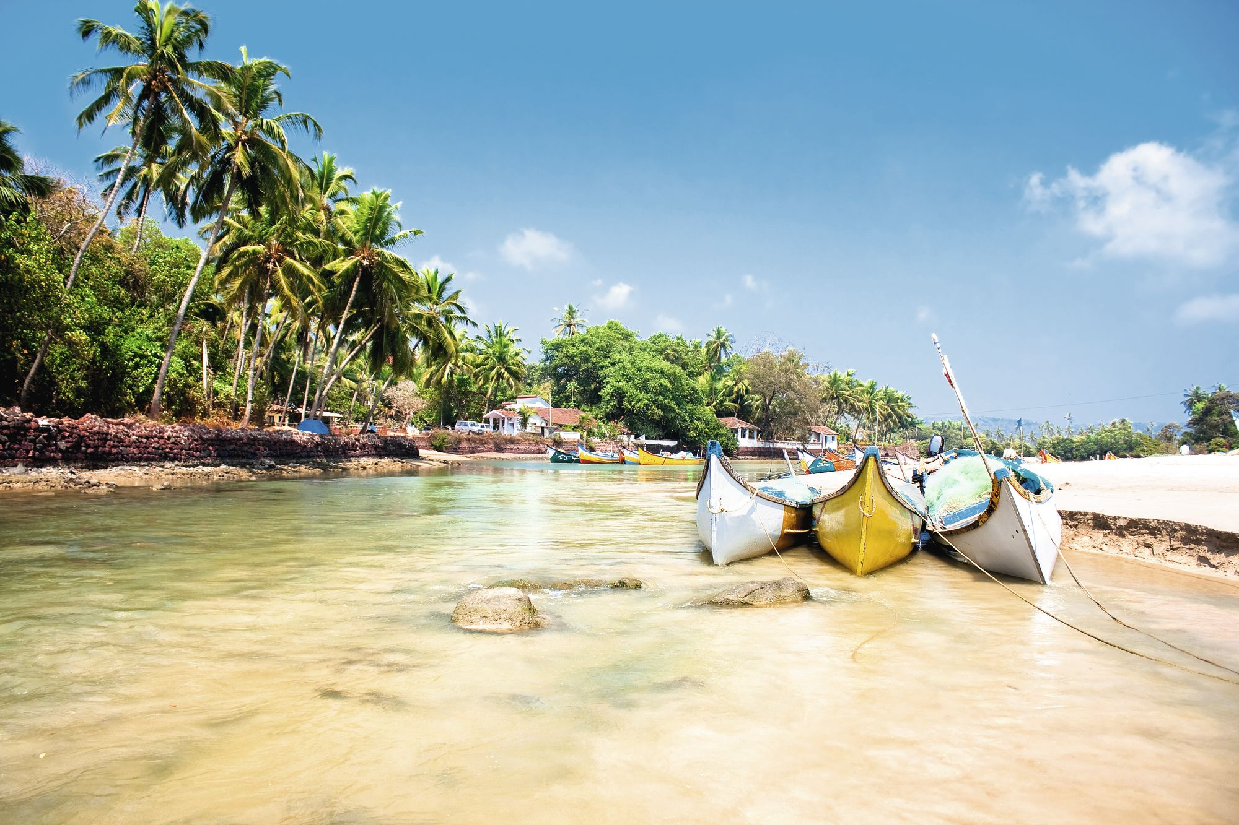
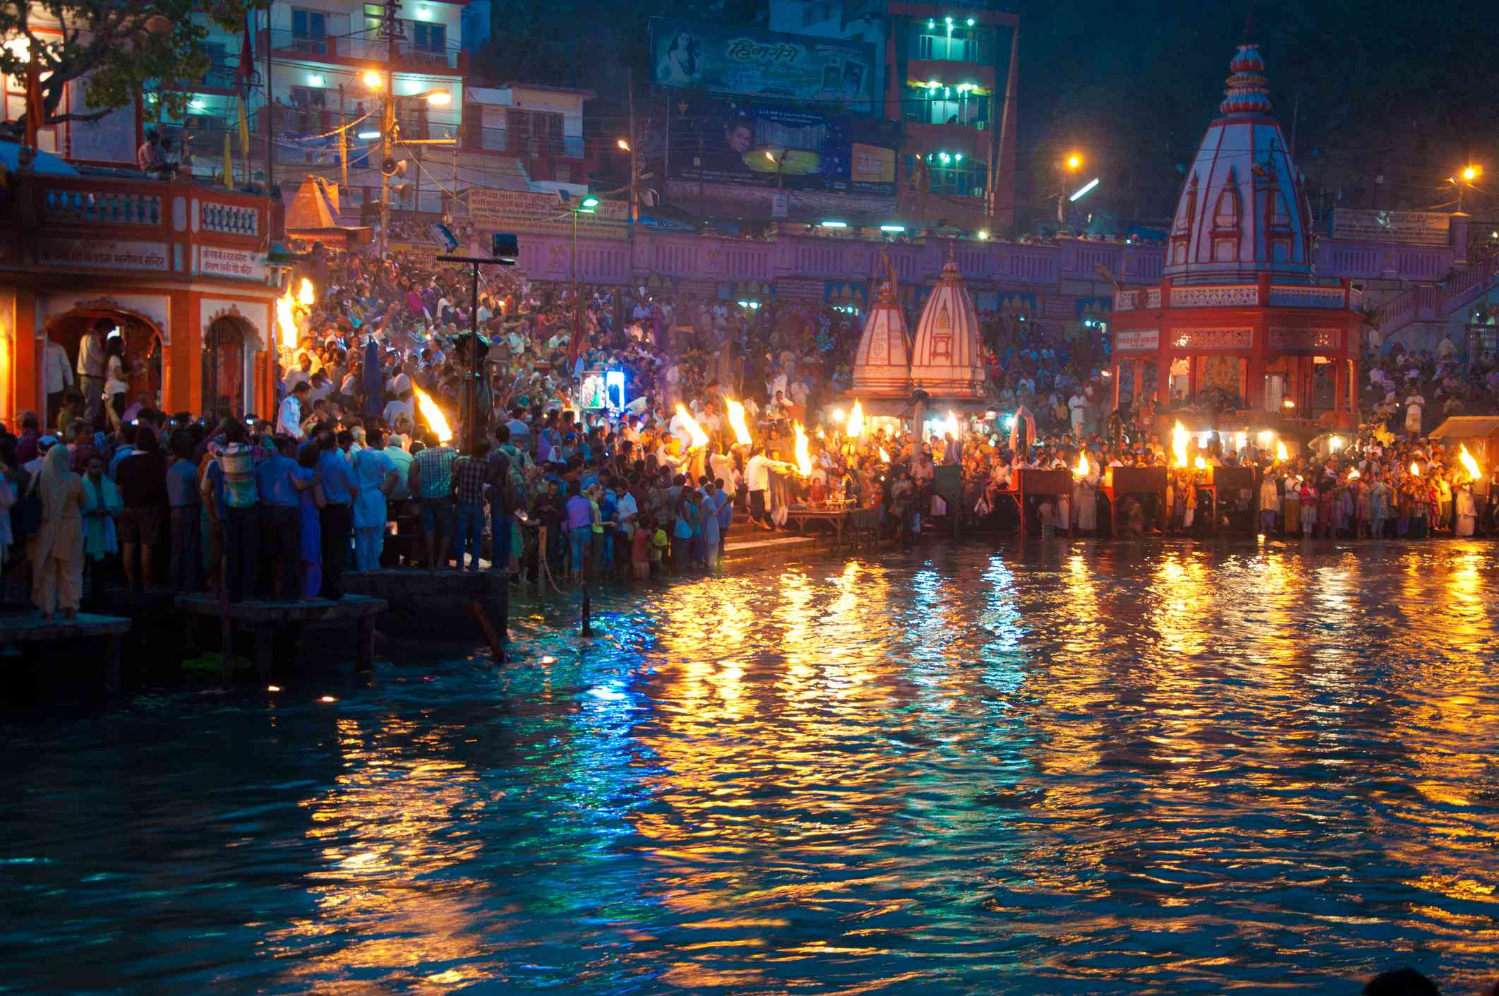
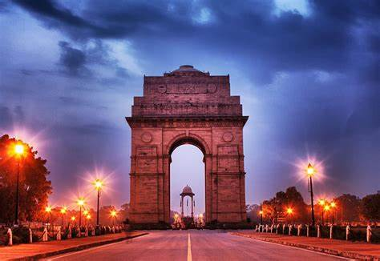
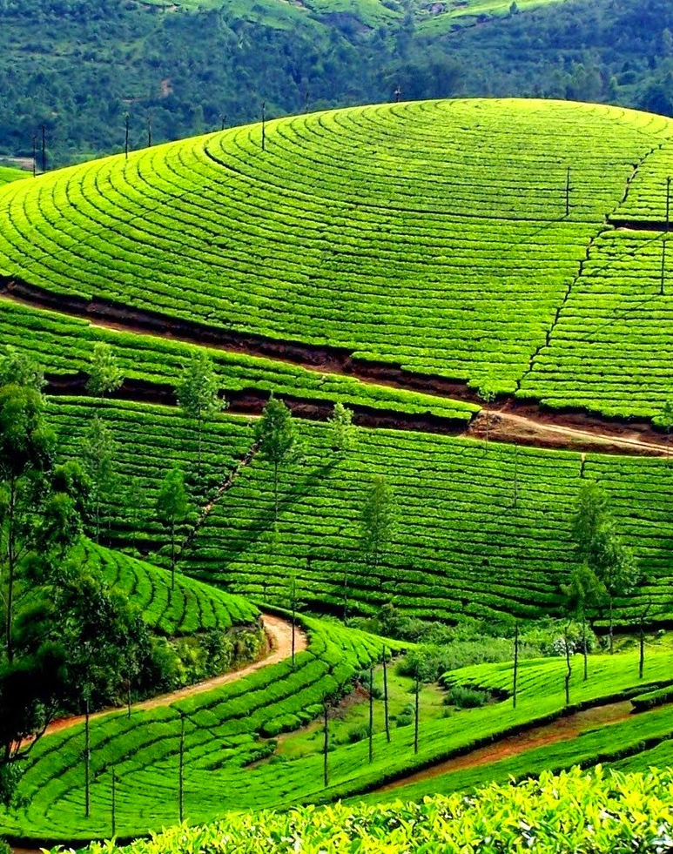
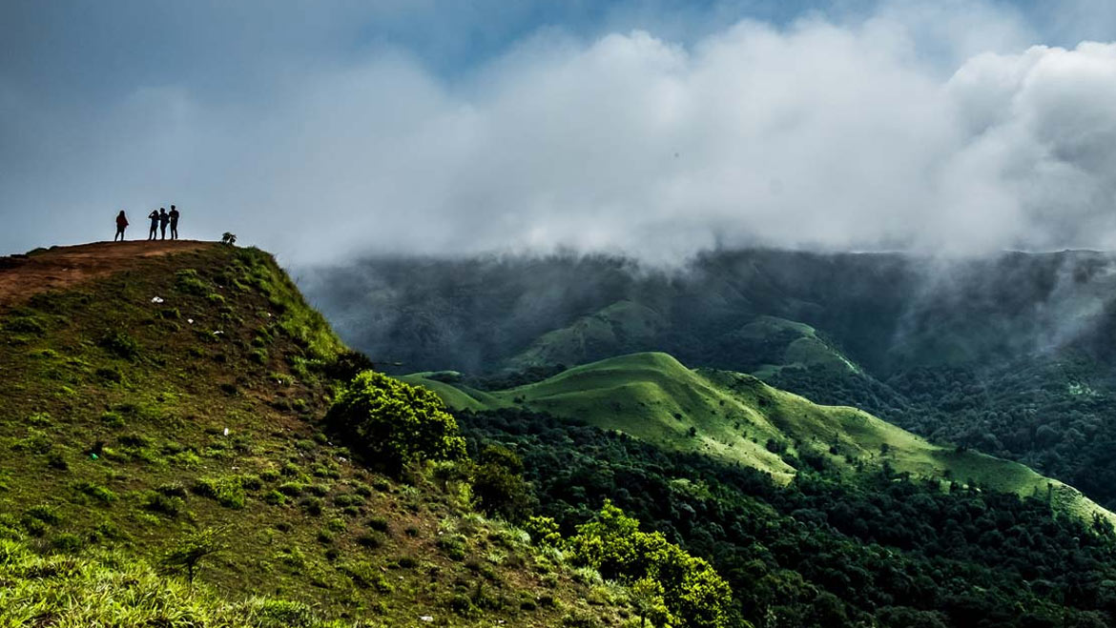
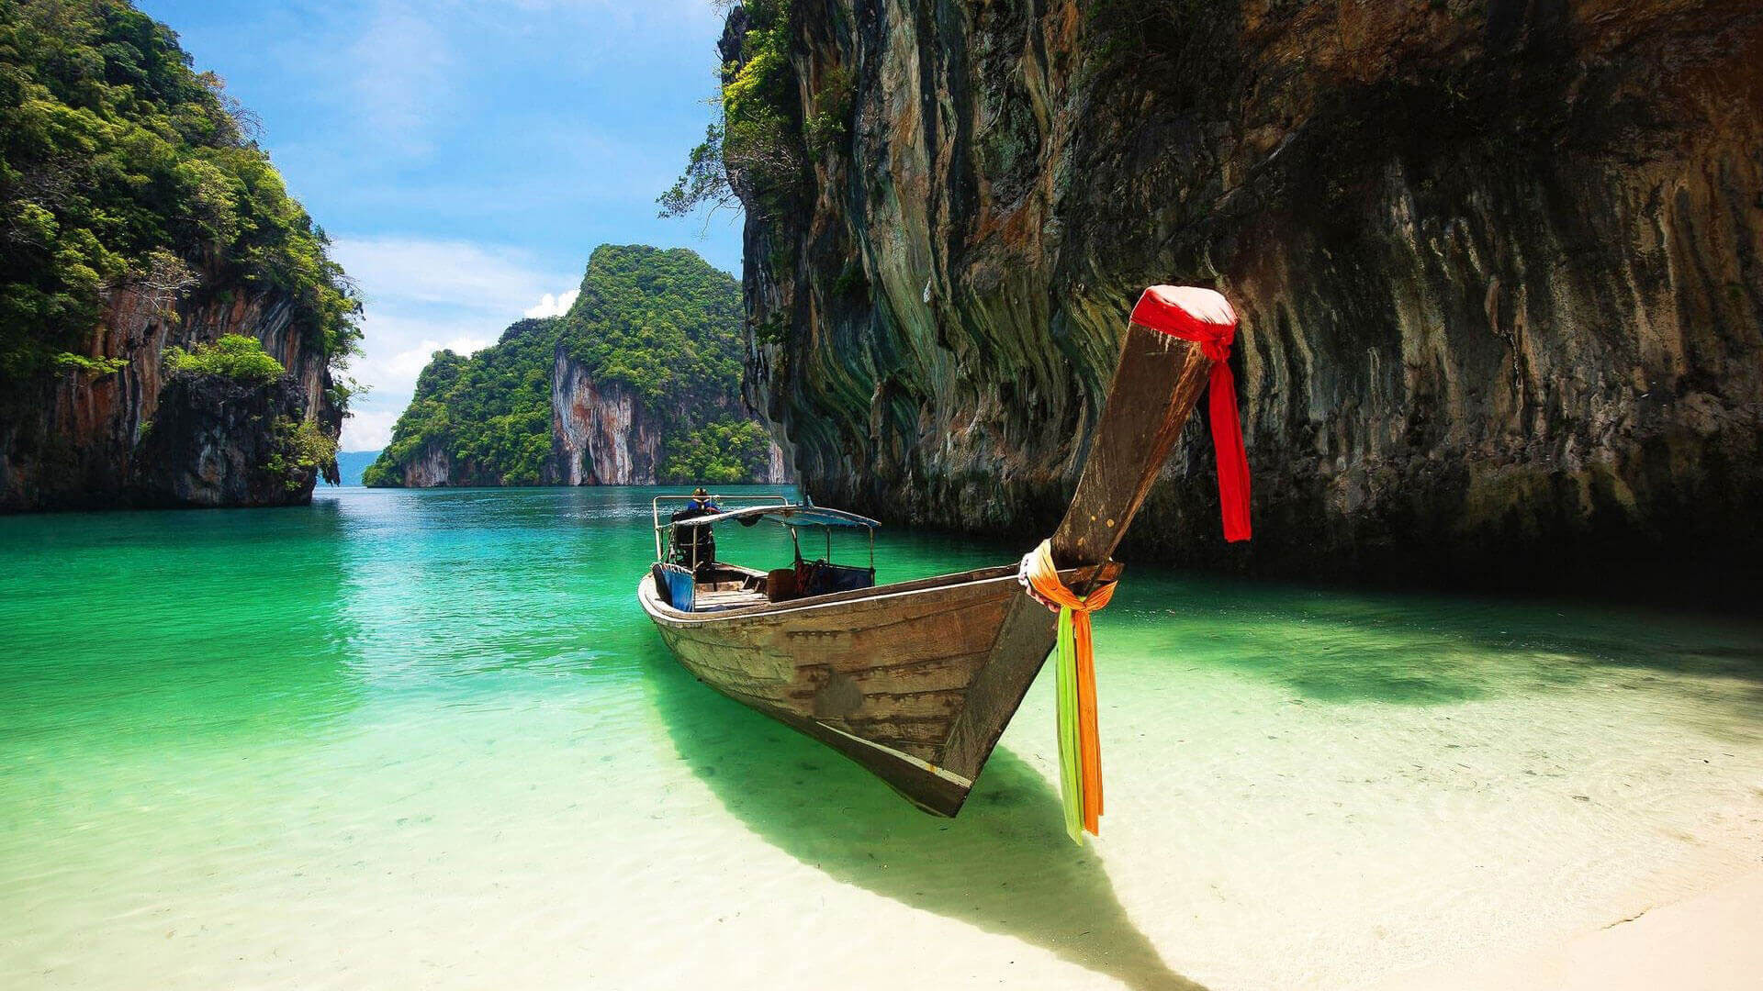
Slide title 7
Shimla
Haridwar
Munnar
Goa
New Delhi
Ooty
Coorg
Port Blair

Slide 13
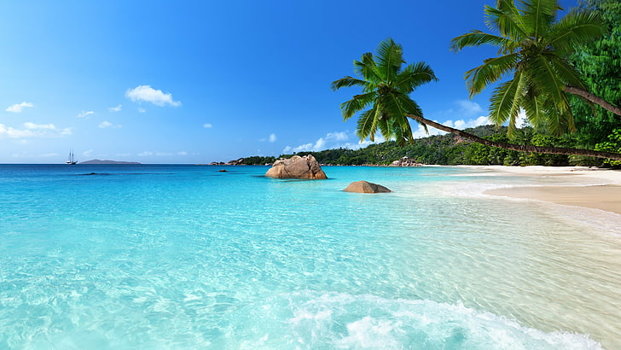
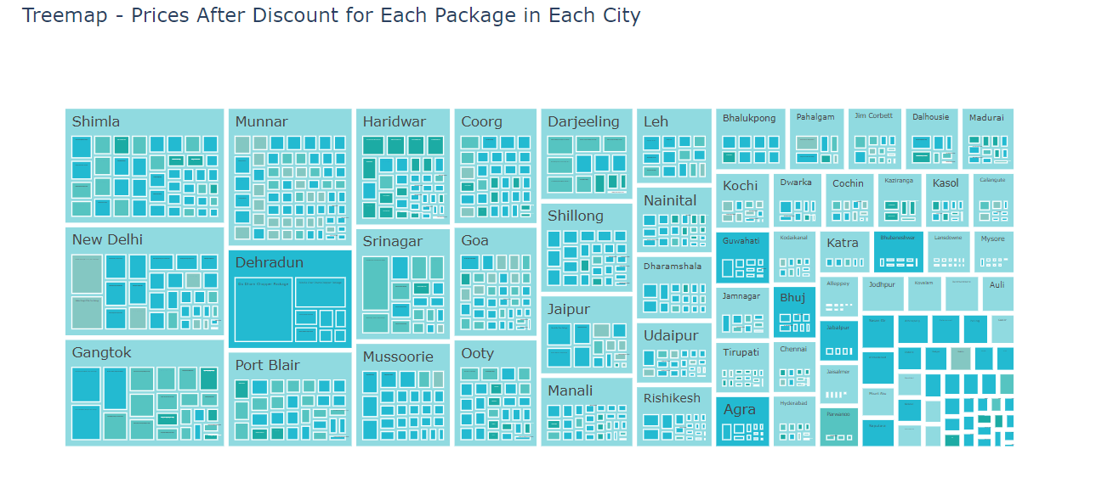
Enhancing Market Strategies for Diverse Travel Offerings
Insights:
Price After Discount: Prices vary across packages due to factors like duration, destination, and inclusions.
Cities: Some cities have more package options, indicating their popularity among travelers.
Star Hotels: Various hotel star ratings offer options catering to different budgets and preferences.
Package Names: The tree map highlights the diversity of package offerings, attracting a wide range of customers.
http://localhost:8888/view/BATCH261_264/Travel_triangle/Tree.html

Slide 14
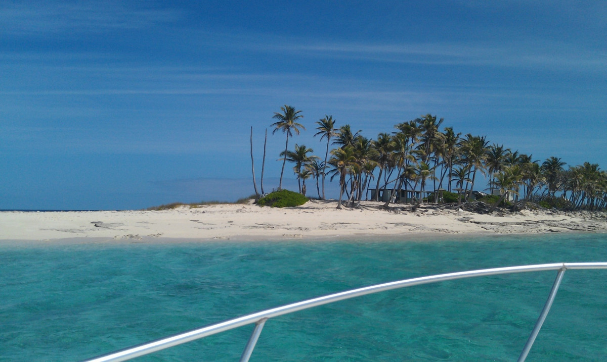
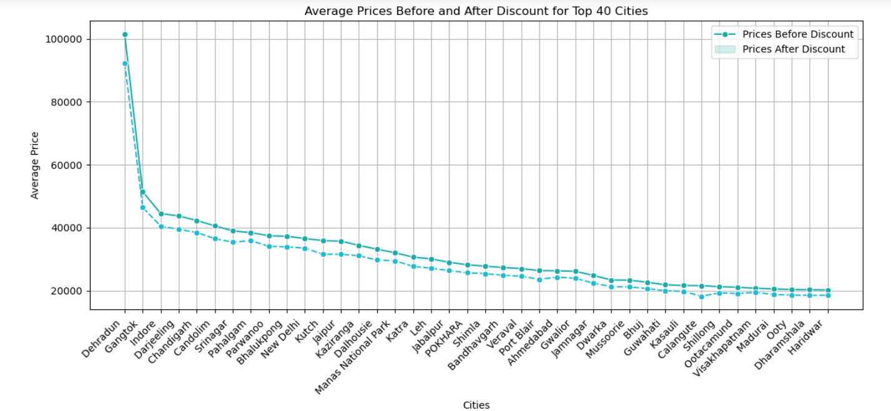
Strategic Pricing Analysis for Competitive Advantage
Insights:
1. Average Discount: Average Discount for all packages is nearly 9.221111463374555%
2. Price Reduction: There is a noticeable reduction in prices after discount across the top 40 cities.
3. Variation Among Cities: While some cities show significant decreases in prices after discount, others have relatively smaller reductions.
4. Pricing Strategies: The extent of discounting may vary depending on factors such as location, competition, and demand.

Slide 15
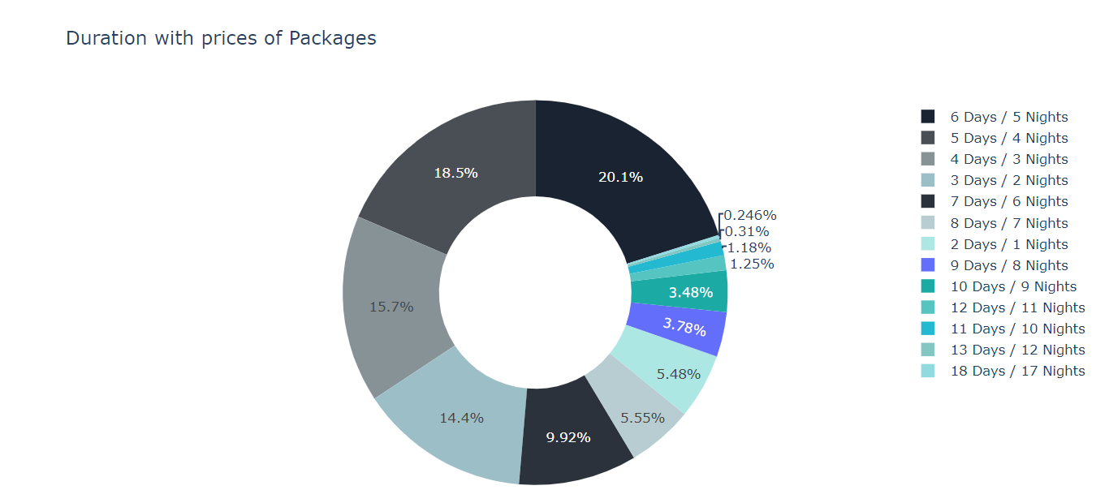
Enhancing Package Duration for Customer Satisfaction
Insights:
The highest percentage of packages (20.1%) corresponds to a duration of 6 days and 5 nights, indicating a preference among customers for longer travel experiences.
Longer durations may offer customers more comprehensive and immersive travel experiences, contributing to higher satisfaction levels and potentially increasing customer retention.
http://localhost:8888/view/BATCH261_264/Travel_triangle/pie.html

Slide 16
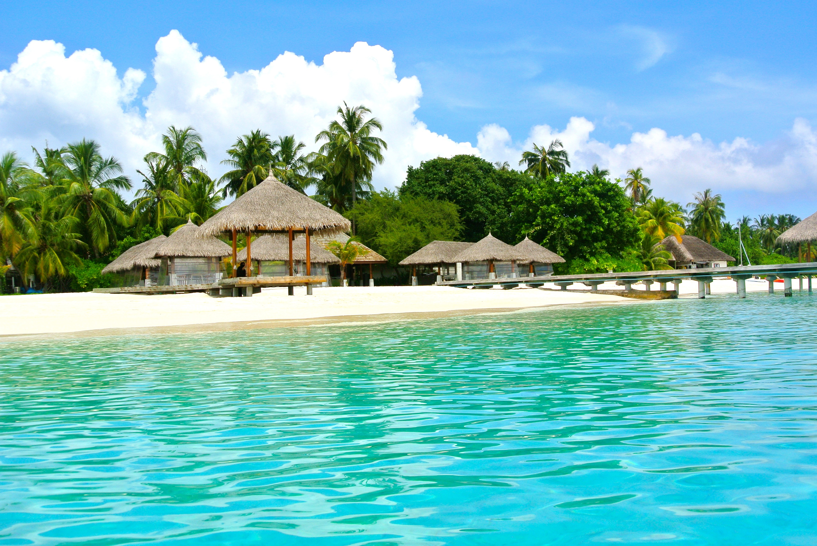
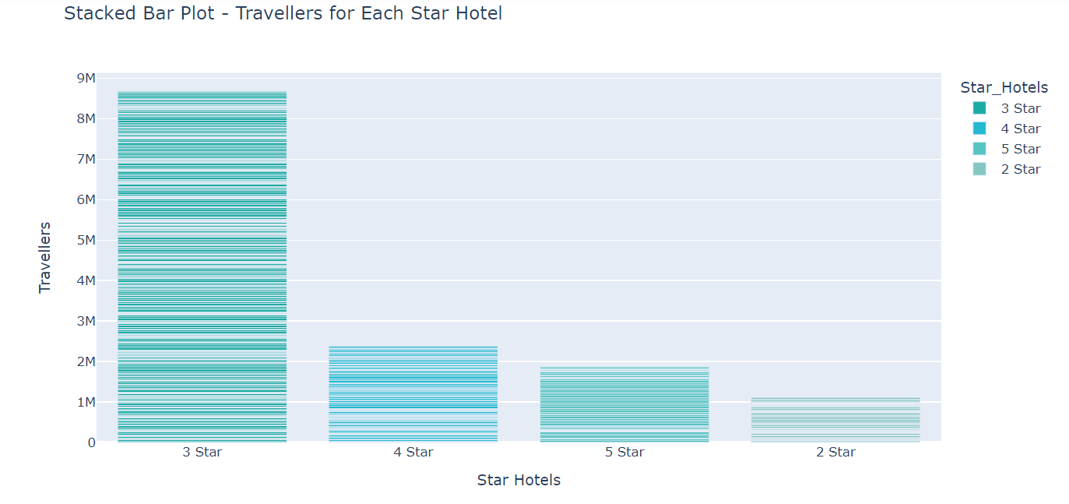
Optimizing Hotel Offerings and Enhancing Customer Satisfaction for Revenue Growth
Insights:
Price Sensitivity: Travelers show a preference for 3-star hotels, indicating a balance between affordability and quality.
Perception of Value: 3-star hotels are perceived as offering the best value, aligning with customer expectations for price, amenities, and service.
Upselling Opportunities: Despite the popularity of 3-star hotels, there are opportunities to upsell higher-star accommodations to customers seeking premium experiences.
Customer Satisfaction: Monitoring satisfaction levels helps maintain service quality and identifies areas for improvement across all hotel categories.
http://localhost:8888/view/BATCH261_264/Travel_triangle/Stacked.html

Slide 17

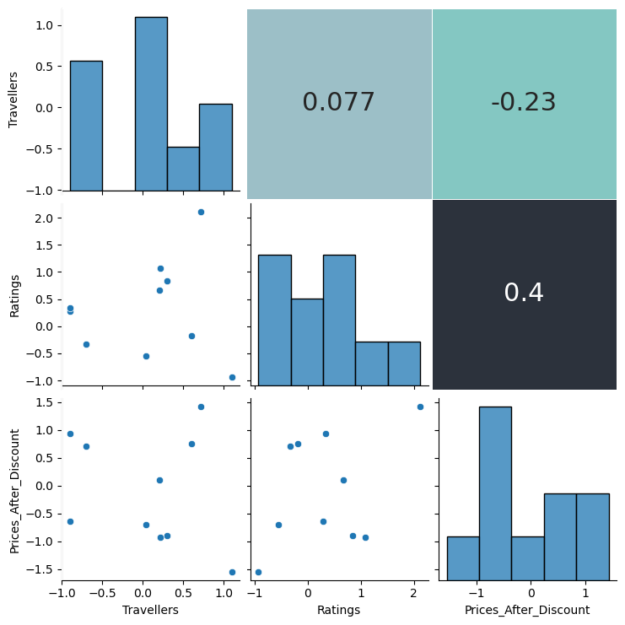
Understanding the Relationship between Traveler Preferences, Ratings, and Pricing
Insights:
1. Pricing Strategies: Explore correlations between traveler ratings and prices to inform effective pricing strategies.
2. Customer Satisfaction: Understand how ratings correlate with traveler numbers to gauge customer satisfaction.
3. Pricing Optimization: Utilize insights to optimize pricing strategies and enhance customer satisfaction and revenue.

Slide 18

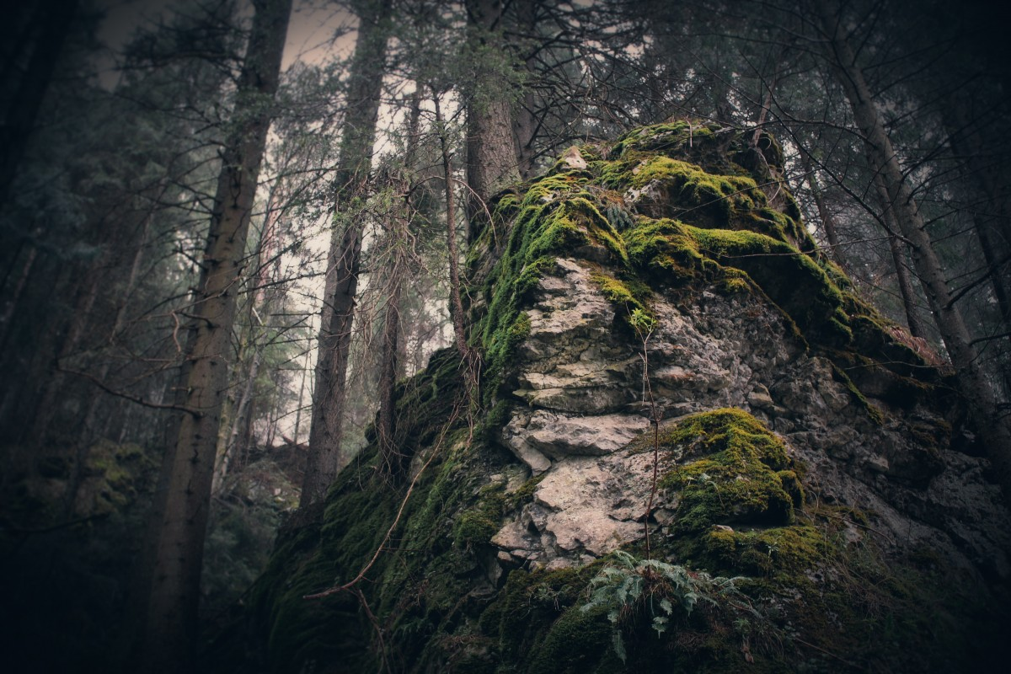
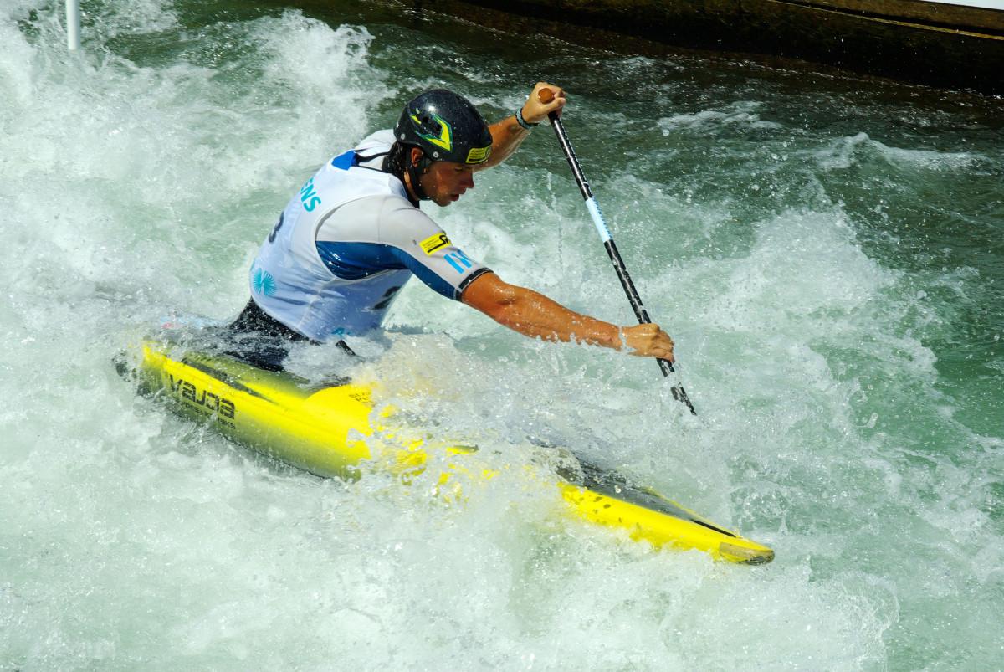
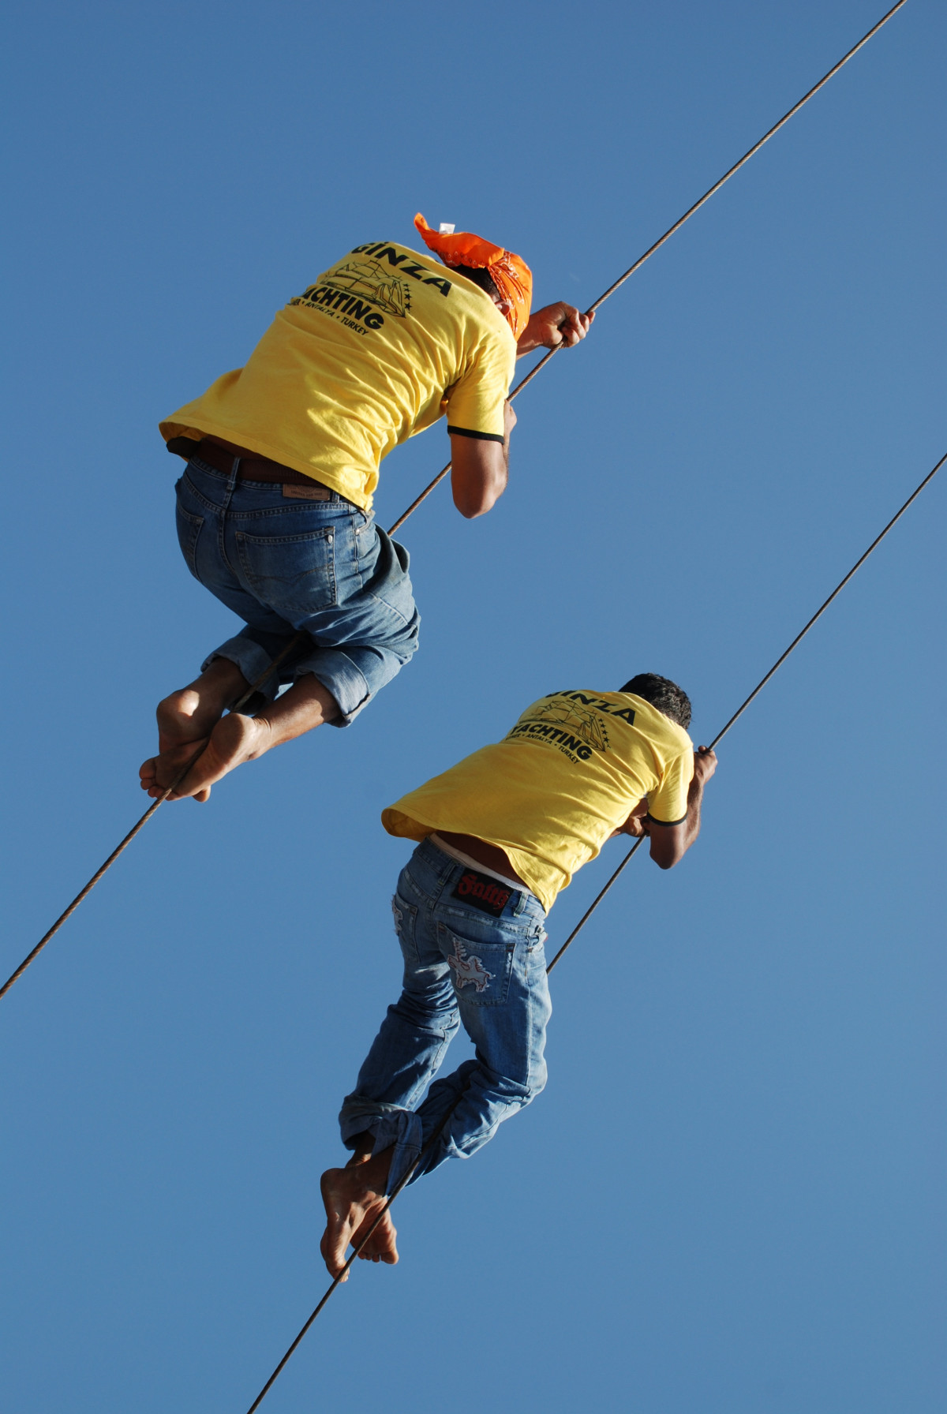
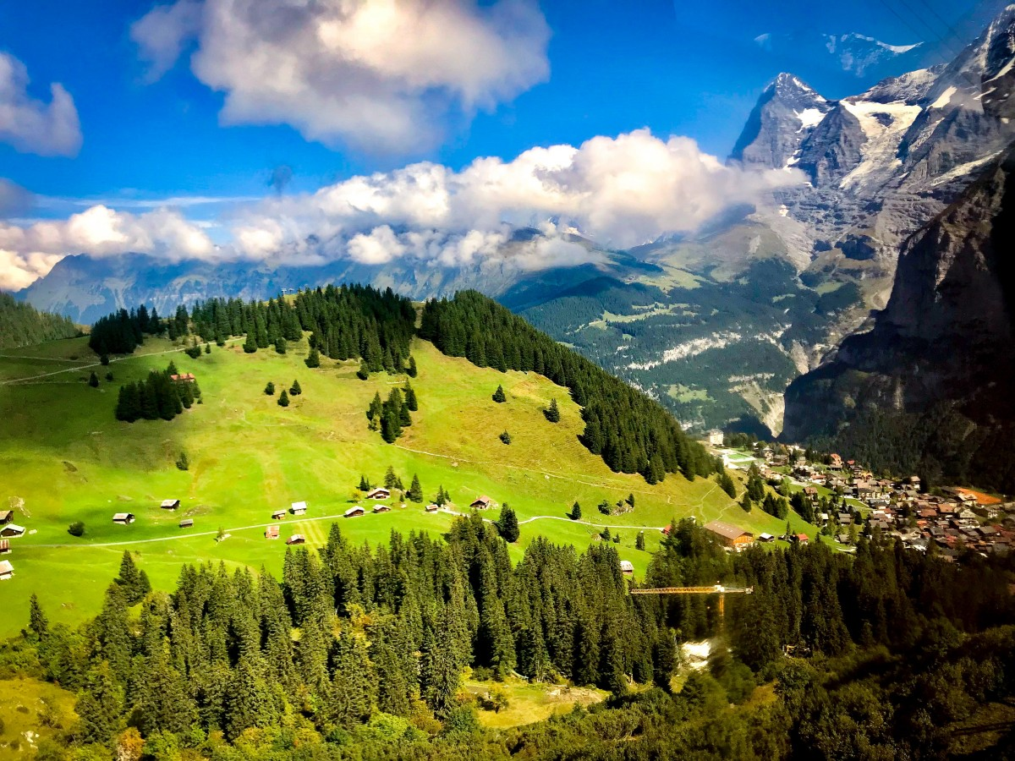
Adventure
Hill Station
Nature
Religious
Water Activity

Slide 19

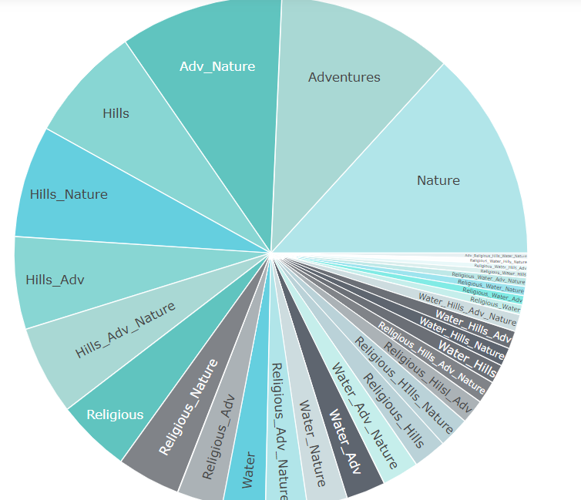
Enhancing Customer Engagement through Tailored Activity Packages
Insights:
High Demand: Nature-themed packages, totaling 795, indicate a strong customer preference for nature-centric travel experiences.
Customer Priorities: The popularity of these packages suggests that travelers prioritize immersive encounters with natural environments.
Market Opportunities: There is potential for TravelTriangle to capitalize on the demand for nature-based tourism by further developing eco-friendly and sustainable travel options.
Competitive Edge: TravelTriangle's extensive portfolio of nature-focused packages positions it as a leading provider of authentic and enriching travel experiences in natural settings.
http://localhost:8888/view/BATCH261_264/Travel_triangle/pie1.html

Slide 20

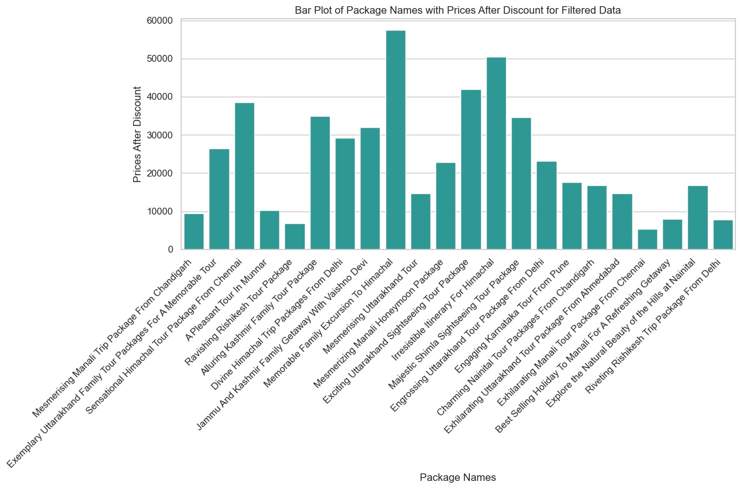
CONCLUTION : Optimizing Pricing Strategies for Travel Packages.(this are the best packages in travel triangle including all the amenities)
Insights:
Price Variation: Diverse package prices.
Feature Preferences: Varied travel feature preferences.
Hotel Choices: Diverse accommodation preferences.
Positive Feedback: Influential ratings and reviews.
Pricing Strategy: Balanced customer value and profitability.
Customer Satisfaction: Feedback-driven improvements.
Competitive Positioning: Understanding strengths and weaknesses.
Personalization: Tailored recommendations.
Strategic Partnerships: Enhancing travel experiences.
Continuous Improvement: Evolving to meet customer needs.

Slide 21
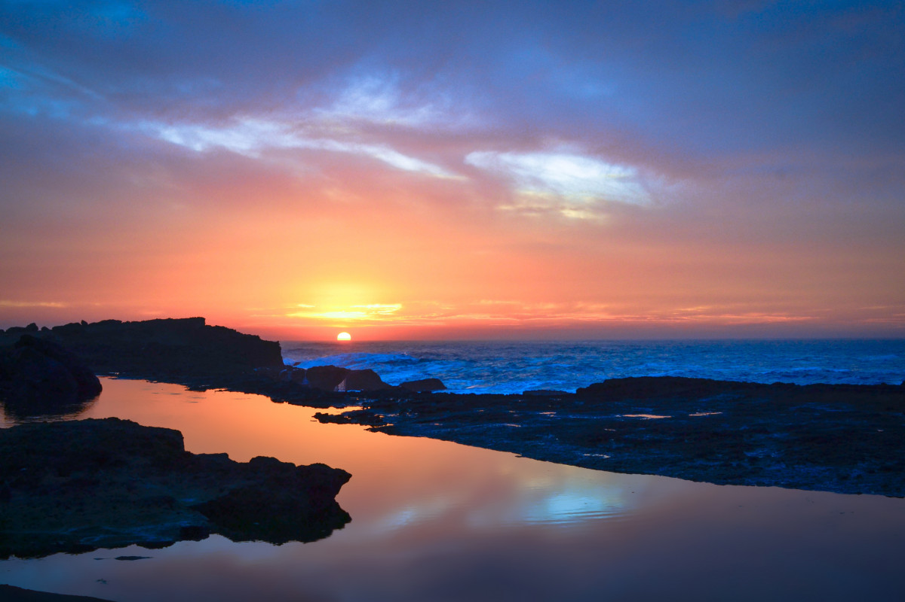
Thank you!☺
S

